Slide 1
Graph theory
Introduction

Slide 2
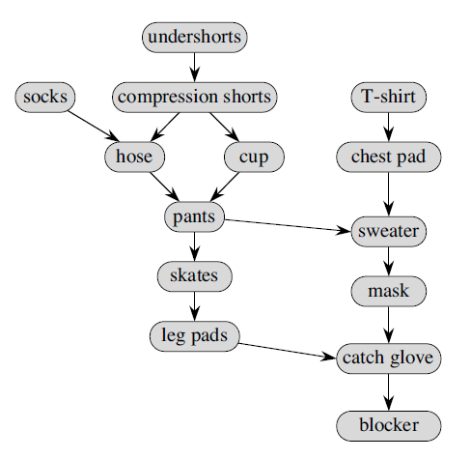
Dress up order – hockey goalie
What will be some of the order of dressing up?
Notes:
The diagram shows which items had to be put on before other items. An arrow from item A to item B indicates a
constraint that A must be put on before B. For example, I have to put on the chest pad before the sweater. Of course, the “must be put on before”
constraint is transitive: if item A must be put on before item B, and item B must be put on before item C, then item A must be put on before
item C. Therefore, I must put on the chest pad before the sweater, mask, catch glove, and blocker. For some pairs of items, however, it doesn’t matter in which order I put them on. I can put socks on either before or after the chest pad, for example.
I needed to determine an order in which to get dressed. Once I had my diagram, I had to come up with a list containing all the items I had
to don, in a single order that did not violate any of the “must be put on before” constraints.

Slide 3
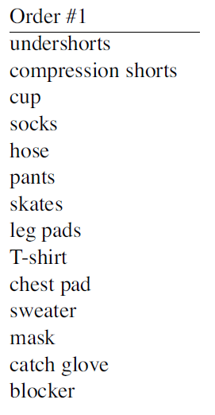

Slide 4
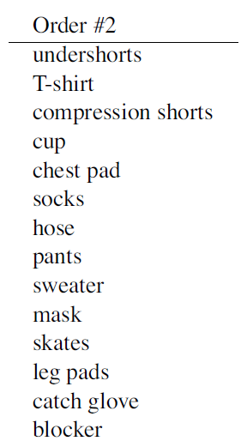

Slide 5
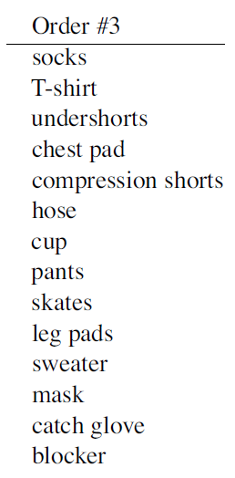

Slide 6
Step 1
Look for item with no incoming arrows, because such an item need not be put on after any other item.
Chose: Undershorts
[undershorts]

Slide 7
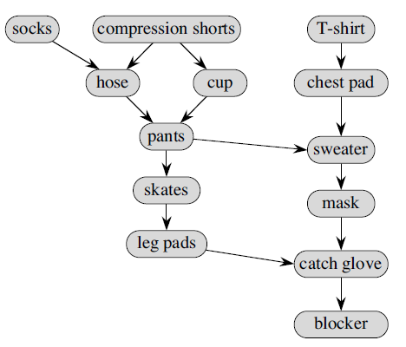
Step 2
Look for item with no incoming arrows, because such an item need not be put on after any other item.
Chose: t-shirt
[undershorts, t-shirt]

Slide 8
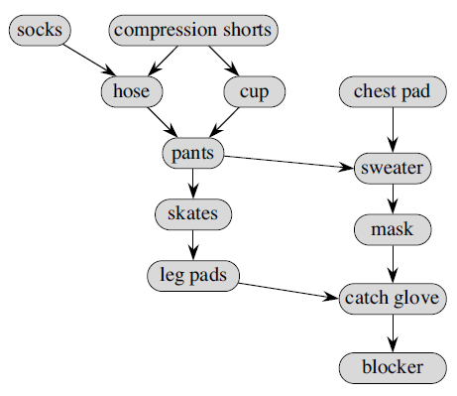
Step 3
Look for item with no incoming arrows, because such an item need not be put on after any other item.
Chose: compression shorts
[undershorts, t-shirt, compression shorts]

Slide 9
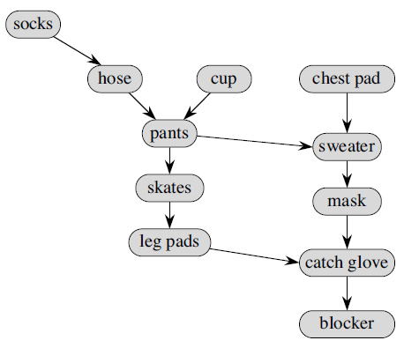
Step 4
Look for item with no incoming arrows, because such an item need not be put on after any other item.
Chose: cup
[undershorts, t-shirt, compression shorts, cup]
You just repeat until all the items are processed

Slide 10
Directed Acyclic Graph (DAG)
Vertex: represents the nodes (hockey equipment)
Edge: represents the relationship between 2 vertices (u, v), i.e. (socks, hose) is highlighted
It’s acyclic because there is no way to “cycle” from a vertex back to itself.
Dags are great for modeling dependencies where one task must occur before another.
Building a house
Cooking
Project management

Slide 11

Topological sort
produces a linear order such that if (u,v) is an edge in the dag, then u appears before v in the linear
order.

Slide 12
in-degree
0
0
1
0
in-degree:
The number of edges entering a vertex
2
1
1
2
2
1
1
1
2
1

Slide 13
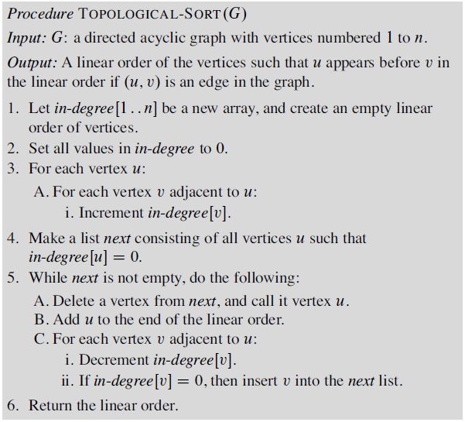

Slide 14
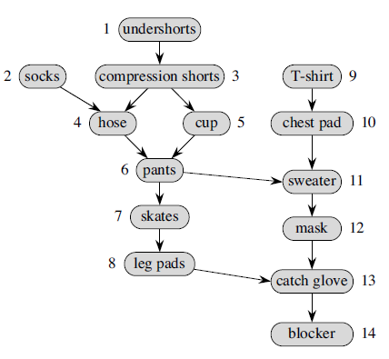
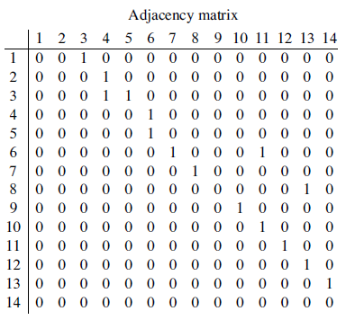
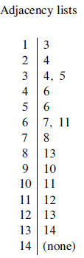
How to represent a directed graph

Slide 15
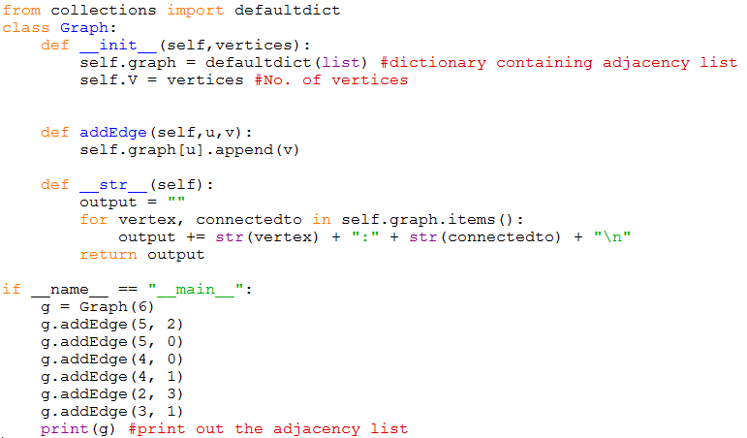

Graph

